Slide 1
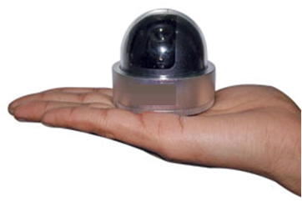
Baby Dome Camera
Metal Body
Moon Info system
www.mooninfosystem.com
Features
Image Sensor: 1/3” CCD
Resolution: 420TVL
Lens: Fixed 3.6mm
Min. Illumination: 0.1Lux/F1.2
AGC: Auto
Body : Metal

Slide 2
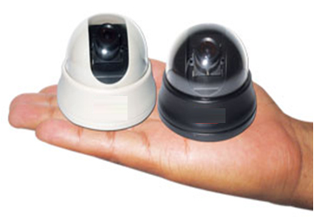
Baby Dome Camera
Moon Info system
www.mooninfosystem.com
Model No: E-MD420
Features
Image Sensor: 1/3” CCD
Resolution: 420TVL
Lens: Fixed 3.6mm
Min. Illumination: 0.1Lux/F1.2
AGC: Auto

Slide 3
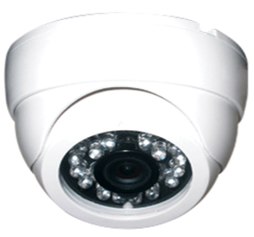
Dome IR Camera
Small Housing
Moon Info system
www.mooninfosystem.com
Features
Image Sensor: 1/3” CCD
Resolution: 420TVL
Lens: Fixed 3.6mm
LUX: 0.001
IR Led 18 Pcs
IR Distance: 20m
AGC: Auto
White Balance : Auto

Slide 4
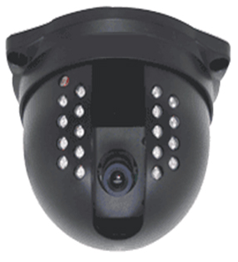
DOME IR CAMERA
Moon Info system
www.mooninfosystem.com
Features
Image Sensor: 1/3” CCD
Resolution: 420TVL
Lens: Fixed 3.6mm
LUX: 0.001
IR Led 18 Pcs
IR Distance: 20m
AGC: Auto
White Balance : Auto

Slide 5
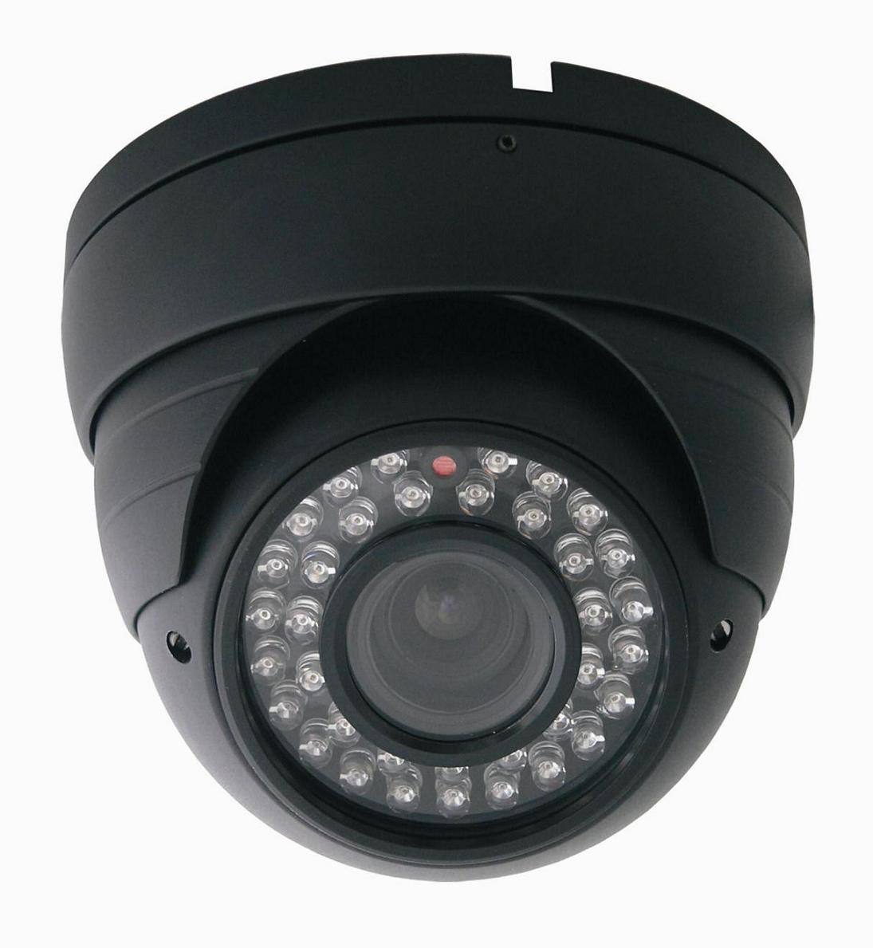
DOME IR CAMERA
Moon Info system
www.mooninfosystem.com
Features
Image Sensor: 1/3” CCD
Resolution: 420TVL
Lens: Fixed 3.6mm
LUX: 0.001
IR Led 36 Pcs
IR Distance: 20m
AGC: Auto
White Balance : Auto

Slide 6
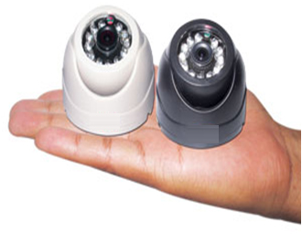
Baby Dome IR Camera
Moon Info system
www.mooninfosystem.com
Features
Image Sensor : 1/3” CCD
Resolution : 420TVL
Lens : Fixed 3.6mm
Min. Illumination : 0.01Lux/F1.2
IR Led : 12
IR Distance: 10m
AGC : Auto

Slide 7
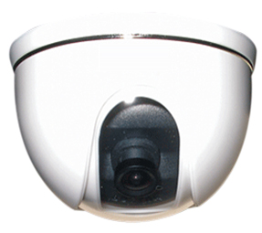
Dome Camera
Moon Info system
www.mooninfosystem.com
Features
Image Sensor: 1/3” CCD
Resolution: 420TVL
Lens: Fixed 3.6mm
LUX: 0.1
AGC: Auto
White Balance : Auto

Slide 8
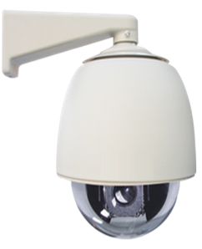
30X PTZ Dome Camera
Moon Info system
www.mooninfosystem.com
Features
High Die-cast Aluminum Construction
Pan range 0°~360° Continuously
Tilt range 0°~90°, 6 cruising tracks
Multi-protocol, RS485 data communication
Image sensor :1/4” super HAD CCD
Zoom : 30X
Min illumination : 1Lux
Horizontal resolution :480TVL
S/N ratio : 50dB
Pan speed : 00 200/s
Tile speed : 00 200/s
Preset : 64(Max)
Active pixels : 752H×582V
Synchronization : Internal/Extrinsic
Video output : VBS 1.0Vp-p/75Ω
White balance : Auto/Manual
Scanning frequency : 15.625KHz(H) 50Hz(V)
Electronic shutter : 1/501/10,000s
Aperture Focal variation : Auto/Manual
Communication : Multi-protocol,RS485
Work temperature : -350C550C
Power supply : AC24V
Power consumption : 35VA
Relative humidity : 90%
Weight : 4Kg
Model No: E-D30

Slide 9
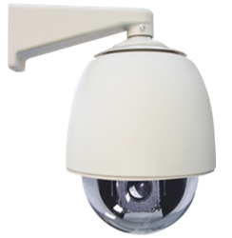
360X PTZ Dome
Camera
Moon Info system
www.mooninfosystem.com
Features
High Die-cast Aluminum Construction
Pan range 0°~360° Continuously
Tilt range 0°~90°, 6 cruising tracks
Multi-protocol, RS485 data communication
Image sensor :1/4” super HAD CCD
Zoom : 360X
Min illumination : 1Lux
Horizontal resolution :480TVL
S/N ratio : 50dB
Pan speed : 00 200/s
Tile speed : 00 200/s
Preset : 64(Max)
Active pixels : 752H×582V
Synchronization : Internal/Extrinsic
Video output : VBS 1.0Vp-p/75Ω
White balance : Auto/Manual
Scanning frequency : 15.625KHz(H) 50Hz(V)
Electronic shutter : 1/501/10,000s
Aperture Focal variation : Auto/Manual
Communication : Multi-protocol,RS485
Work temperature : -350C550C
Power supply : AC24V
Power consumption : 35VA
Relative humidity : 90%
Weight : 4Kg

Slide 10
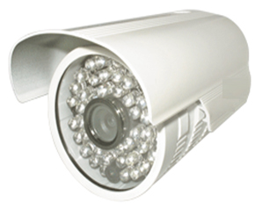
Weatherproof IR
Camera 30 mts.
Moon Info system
www.mooninfosystem.com
Features
Image Sensor: 1/3” CCD
Resolution: 420TVL
Lens: Fixed 3.6mm
IR Led 36 Pcs
IR Distance: 30m
LUX: 0.001
White Balance: Auto
AGC: Auto

Slide 11
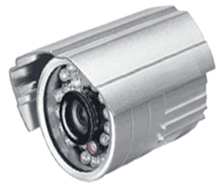
Weatherproof IR Camera
20 mts.
Moon Info system
www.mooninfosystem.com
Features
Image Sensor: 1/3” CCD
Resolution: 420TVL
Lens: Fixed 3.6mm
IR Led 18 Pcs
IR Distance: 20m
LUX: 0.001
White Balance: Auto
AGC: Auto

Slide 12
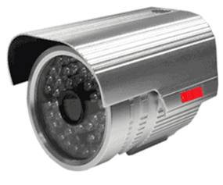
Weatherproof IR Camera
40 mts.
Moon Info system
www.mooninfosystem.com
Specification
Image Sensor: 1/3” CCD
H. Resolution: 420TVL
Standard Board Lens: 6mm
48 Led IR
Weather Proof body
IR Visible Distance: 40m
LUX: 0.001
White Balance: Auto
AGC: Auto

Slide 13
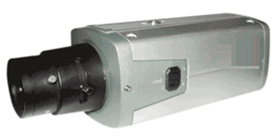
Moon Info system www.mooninfosystem.com
C mount Camera
2 Way Audio & Auto IRIS
Features
Image Sensor: 1/3” CCD
Resolution: 420TVL
AGC: ON/OFF Switchable
White Balance: ON/OFF Switchable
Auto IRIS Control: VD/DC Switchable
BLC: ON/OFF Switchable
LUX: 0.1
Audio : 2 Way
Notes:
Arvind

Slide 14
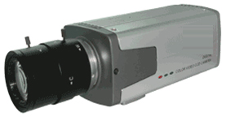
C mount Camera
With Auto IRIS
Moon Info system
www.mooninfosystem.com
Features
Image Sensor: 1/3” CCD
Resolution: 420TVL
AGC: ON/OFF Switchable
White Balance: ON/OFF Switchable
Auto IRIS Control: VD/DC Switchable
BLC: ON/OFF Switchable
Audio : Yes

Slide 15
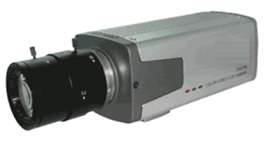
C mount Camera
with Audio
Moon Info system
www.mooninfosystem.com
Features
Image Sensor: 1/3” CCD
Resolution: 420TVL
AGC: ON/OFF Switchable
White Balance: ON/OFF Switchable
BLC: ON/OFF Switchable
LUX: 0.1
Audio : Yes

Slide 16
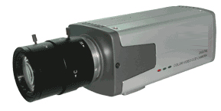
C mount Camera
with Audio & Auto IRIS
Moon Info system
www.mooninfosystem.com
Features
Image Sensor: 1/3” CCD
Resolution: 420TVL
AGC: ON/OFF Switchable
White Balance: ON/OFF Switchable
Auto IRIS Control: VD/DC Switchable
BLC: ON/OFF Switchable
LUX: 0.1
Audio : Yes

Slide 17
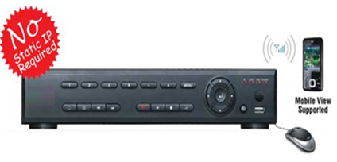
Standalone DVR
4/8/16 Channel
Moon Info system
www.mooninfosystem.com
Features
Real time H.264 DVR
4 Channel - 100FPS (PAL) / 120FPS (NTSC)
8 Channel - 200FPS (PAL) / 240FPS (NTSC)
16 Channel - 400FPS (PAL) / 480FPS (NTSC)
No Static IP Required
Plug & Play DDNS
Supports SATA HDD
USB Backup
USB Mouse Supported
Supports Mobile View on GPRS & 3G

Slide 18
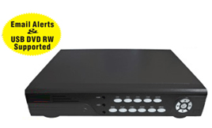
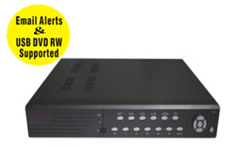
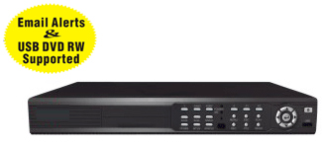
Pentaplex 4/8/16 Channel Standalone DVR
Moon Info system
www.mooninfosystem.com
Features
H.264 video compression format
Support mouse control
4 channel BNC video option (1 BNC & 1 VGA)
Video input/output: 8 Channel / 1 Channel
Video input/output: 16 Channel / 1 Channel
Audio input/output: 4 Channel / 1 Channel
Video source option: NTSC/PAL
100 FPS (PAL) / 120 FPS (NTSC)
200 FPS (PAL) / 240 FPS (NTSC)
400 FPS (PAL) / 480 FPS (NTSC)
Motion detection with secitivity and area settings
Time schedule/motion triggered/alarm/manual recording
Mobile view supported
CMS software bundled
Embedded Linux OS
Support record file back-up via USB
Support 1 HDD with capacity up to 2TB
Graphic user interface
Panel remote operation
Plug & play DDNS, no router setting required

Slide 19
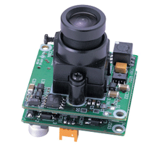
Dual Board with
Audio Camera
Moon Info system
www.mooninfosystem.com
Features
Image Sensor: 1/3” Dual CCD
Resolution: 420TVL
Lens: Fixed 3.6mm
LUX: 0.1
AGC: Auto

Slide 20
Dual Board
Camera
Moon Info system
www.mooninfosystem.com
Features
Image Sensor: 1/3” Dual CCD
Resolution: 420TVL
Lens: Fixed 3.6mm
LUX: 0.1
AGC: Auto

Slide 21
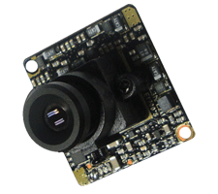
Single Board
Camera
Moon Info system
www.mooninfosystem.com
Features
Image Sensor: 1/3” CCD
Resolution: 420TVL
Lens: Fixed 3.6mm
LUX: 0.1
AGC: Auto

Slide 22
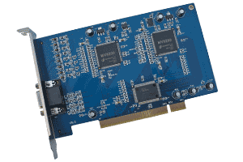
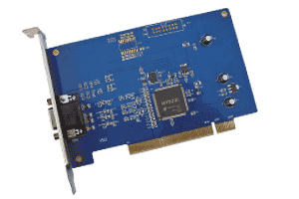
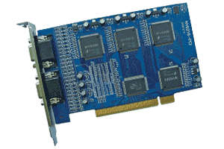
PC Based DVR Card
4/8/16 Channel
Moon Info system
www.mooninfosystem.com
Model No: E-4A8V
Model No: E-4AV
Features
H.264 Compression
Real time Supported
4 Channel - 100FPS (PAL) / 120FPS (NTSC)
8 Channel - 200FPS (PAL) / 240FPS (NTSC)
16 Channel - 400FPS (PAL) / 480FPS (NTSC)
Recording Resolution: 352x288 (CIF)
Plug & Play DDNS
Supports Mobile View on GPRS & 3G
No Static IP Required
Model No: E-8A16V

Slide 23
